Slide 1

Cars: Our Second Home

Slide 2

I decided to create this website because of my passion for cars.
The website is a car forum made for cars enthusiasts and people that want to learn or discuss anything cars related.

Slide 3
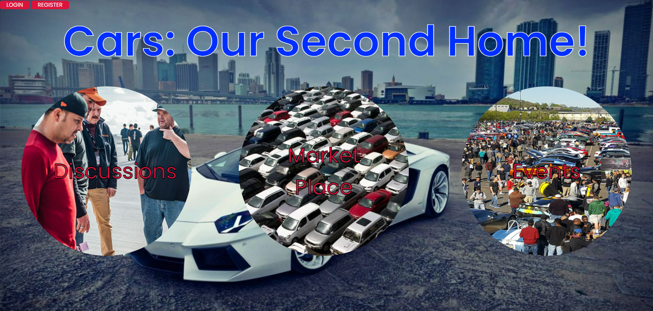
This is the home page where users can login/ register if they want to create posts or add comments to existing posts and the 3 main topics of the website: Discussions/ Market Place/ Events.

Slide 4
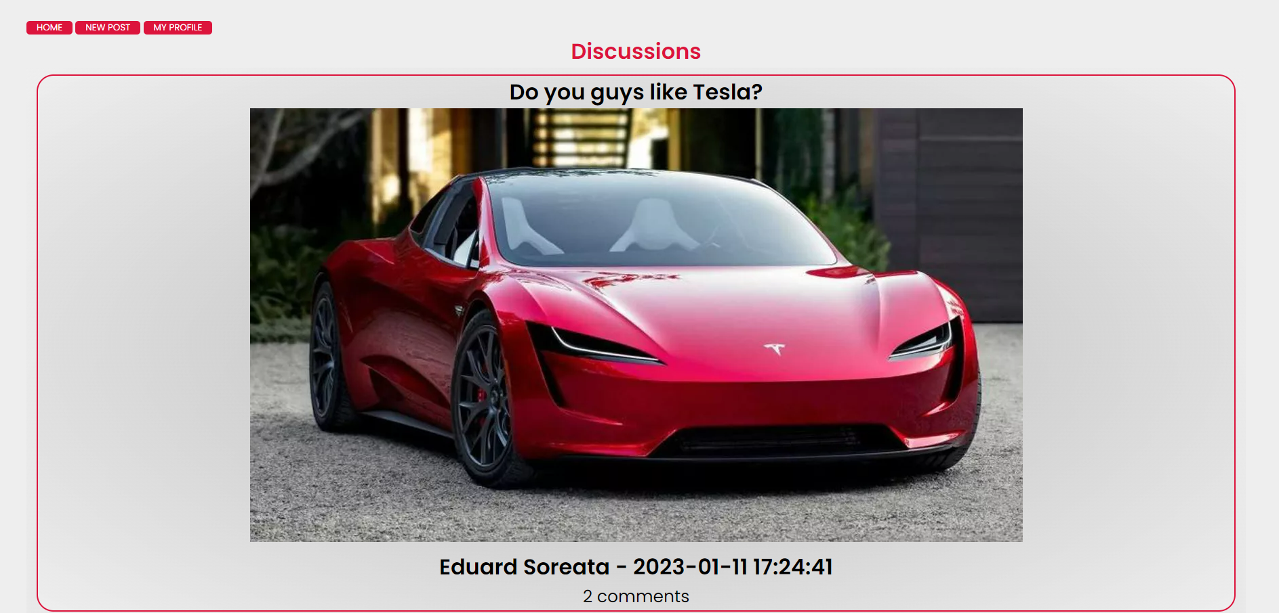
This is the way the posts show up on each topic, clicking on the post title takes you to the post and its comments, clicking on the author takes you to its profile.
Clicking on new post takes you to the post creation page of the current topic (Discussions).

Slide 5
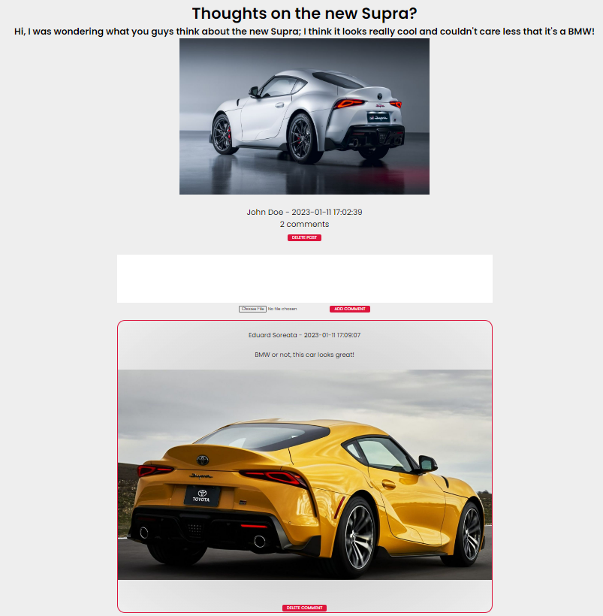
This is the design of the threads. If you are logged in you are allowed to post comments and delete your posts/ comments. If you are an admin you can delete any post/ comment. Clicking on any user name will take you to that user’s profile.

Slide 6
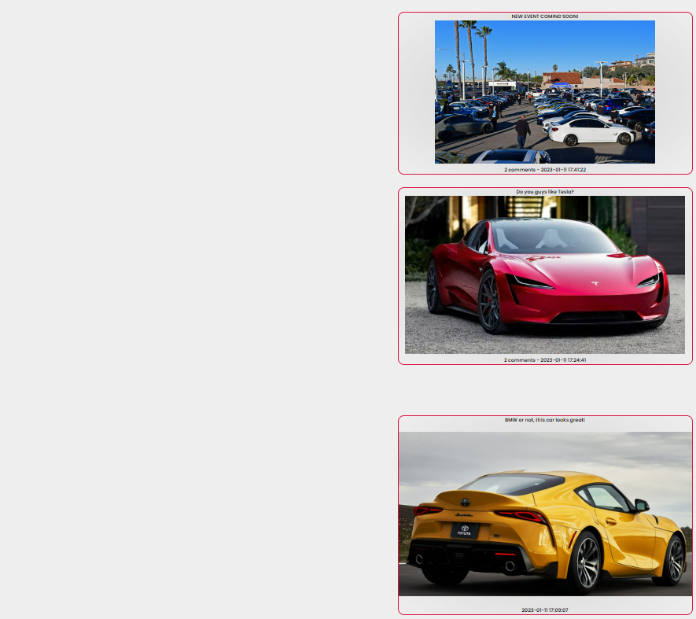
This is the layout of the user profile page.

Slide 7




The website was created using HTML, CSS, PHP and MYSQL.

Slide 8

Thank you!

